Slide 1
Neural Networks and Fuzzy logic
Lab 1

Slide 2
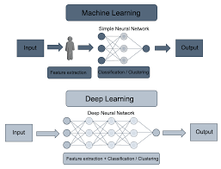
What is machine learning ?
Machine learning (ML) is the study of computer algorithms that can improve automatically through experience and by the use of data.

Slide 3
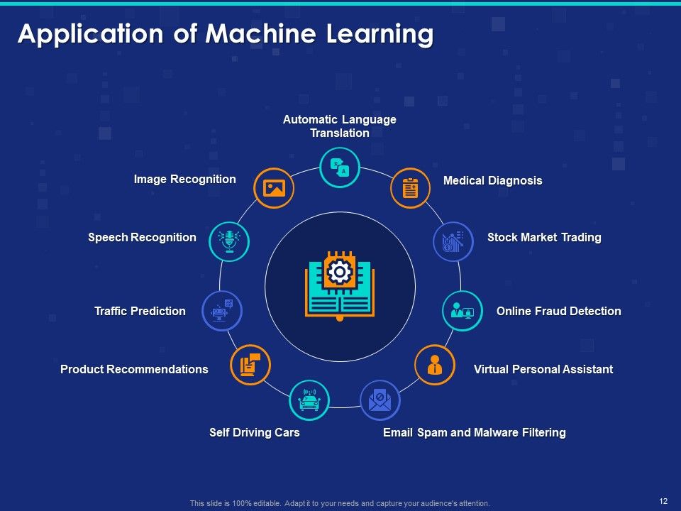
Applications of machine learning and NNT Approach
Notes:
NNT approach (Churn prediction):
1- understand and specify the problem in terms of inputs and desired outputs
2- take the simplest form of nnt which proved to work in such sincaro
3-try to find the appropriate connection weights
4- use different sets of data (training, validation, testing)
5- network doesn’t perform it again and go to step 3
6- if network still performs bad, go to step 2
7- if network silll performs bad, go to step 1

Slide 4
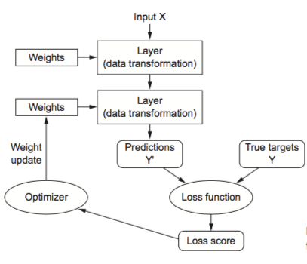
Flow chart of NNT

Slide 5
Machine learning, learning Paradigms
1- Supervised learning (regression, classification, recommendations systems)
2- Unsupervised learning(clustering, anomaly detection, dimensionality reduction)
3- Reinforcement learning( sequential decision making)
“The purpose of machine learning is to automatically adjust the values of w1 and w2 to find a suitable decision boundary! But to do this, we need to mathematically specify some loss or objective function.”
Notes:
The Learning paradigm is a model of the environment in which the neural network operates.

Slide 6
Learning, convergence, activation functions
Learning is a process by which the free parameters of a neural network are adapted through a process of stimulation by the environment in which the
network is embedded( reduce the error)
A learning rule, also known as training algorithm, is defined as a procedure for modifying the weights and biases of a network.(Hebbian, Gradient descent, Competitive, Stochastic.)
Activation functions( Binary classification sigmoid, multi-class classification softmax, regression (linear, relu))

Slide 7
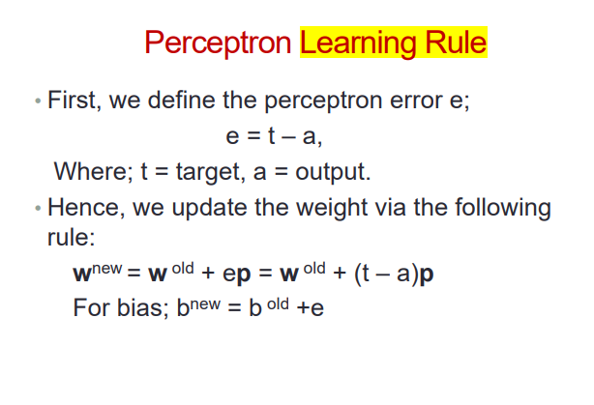
Perceptron learning rule (error function, learning rate, old/new weights)

Slide 8
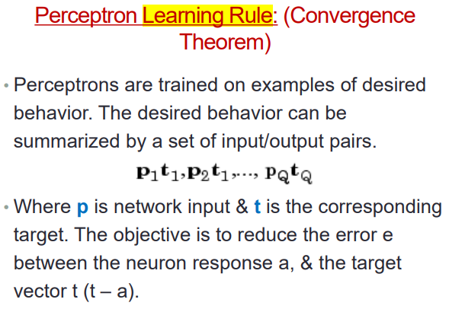

Slide 9
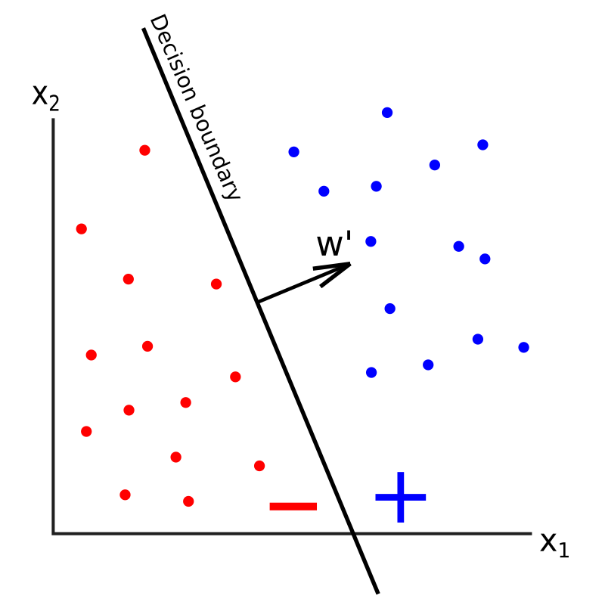
Decision boundary and convergence
• The decision boundary is a line in the input space (vector space); on one side of the line, the network output is 0 while on the other side, the network output is 1.

Slide 10
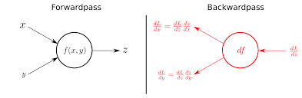
Backpropagation & Gradient Descent:
Stochastic gradient descent is an optimization algorithm for minimizing the loss of a predictive model with regard to a training dataset. Back-propagation is an automatic differentiation algorithm for calculating gradients for the weights in a neural network graph structure. .

